Slide 1
Scrapy Project Multi-Class Text Classification with Scikit-Learn
Felipe da Silva Santos

Slide 2
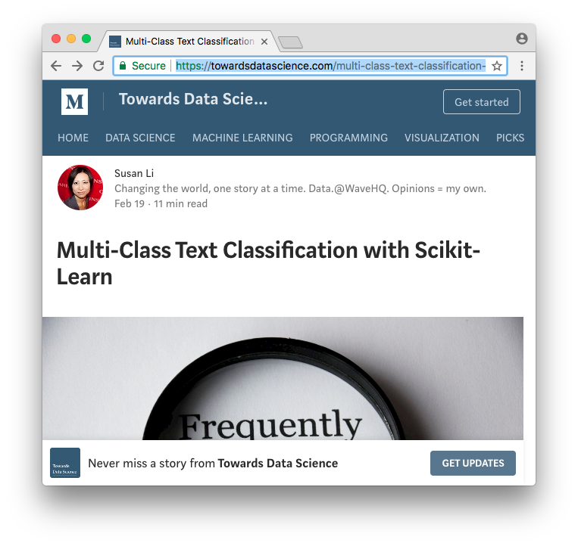
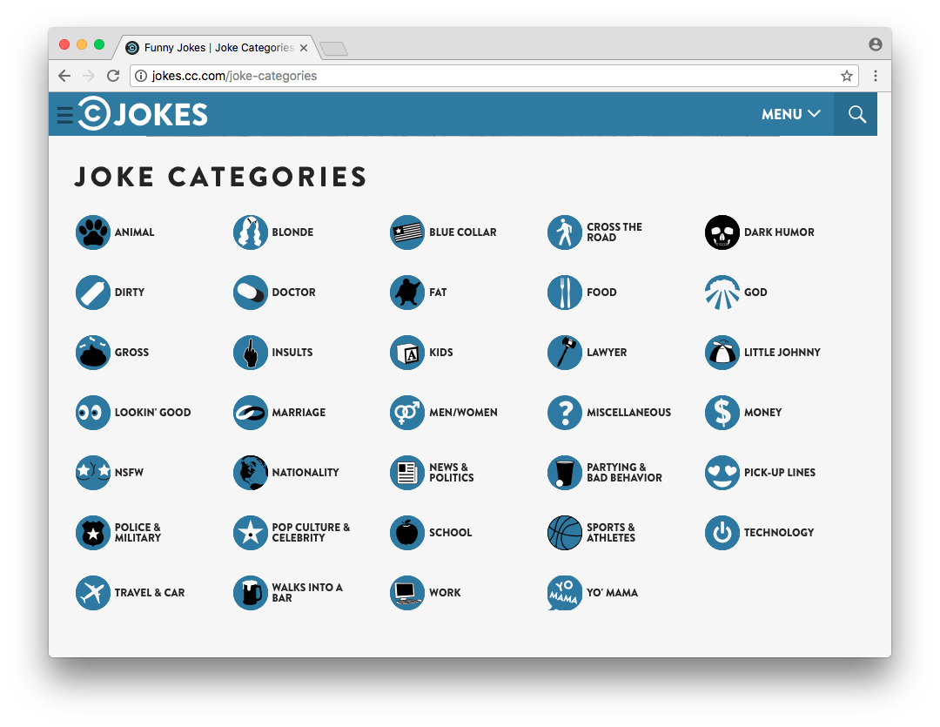
Introduction
Susan’s article
Classifying costumer finance complaints into 12 pre-defined classes.
Does it work in different situations?
Scrapy
Source of data.

Slide 3
Steps
Tf–idf term weighting
Naive Bayes Classifier
Random Forest
Logistic Regression
Data (scrapy)
Accuracy

Slide 4
34 Imbalanced Classes
Accuracy
Model | Train | Test*
Naive Bayes Classifier | 39% | 17%
Random Forest | 30% | 15%
Logistic Regression | 43% | 18%
* Test size: 20%

Slide 5
5 Balanced Classes
Accuracy
Model | Train | Test*
Naive Bayes Classifier | 60% | 38%
Random Forest | 61% | 35%
Logistic Regression | 65% | 39%
* Test size: 20%

Slide 6
Improvements
Tuning the models parameters properly (GridSearchCV);
Finding the appropriate metrics to compare the model’s performance.

